Slide 1
Multiplying Fractions Lesson 5
How does multiplying by a fraction or by a mixed number affect the size of the product?

Slide 2
How can these tiles be used to find 2/3 of 12?
What is 2/3 of 12 markers?
What is 1/3 of 12 markers?
8
4
2/3 × 12 = 8 and 1/3 × 12 = 4

Slide 3
Count out 15 markers. What is 2/5 of these markers?
2/5 × 15 = 6
What is 4/5 of 15 markers? Write the multiplication equation.
4/5 × 15 = 12

Slide 4
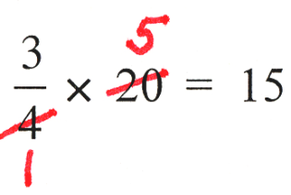
What is ¾ of 20 markers?
15
1
2
3
4
5

Slide 5
Use canceling to compute the following products:
3/5 × 50 1/4 × 40 2/3 × 27 5/6 × 24
Round the whole number

Slide 6


Using Fraction Bars

Slide 7

1/2 of 1/3 is equal to 1/3 of 1/2 This is an example of the commutative property. In this case
1/2 × 1/3 = 1/3 × 1/2 = 1/6.

Slide 8

2/3 × 1/2 = 2/6

Slide 9
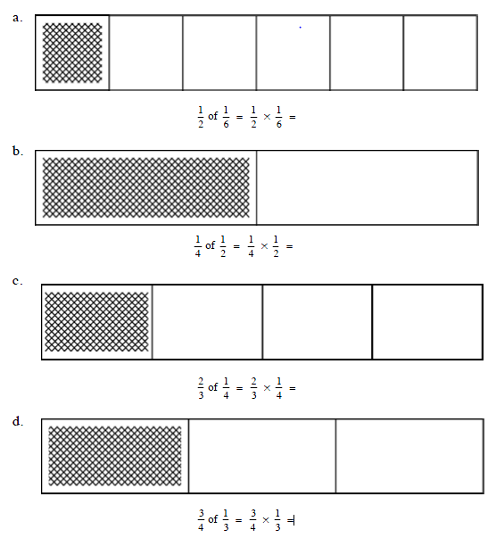

Slide 10
Compare and look for relationships.
1/2 × 1/3 = 1/6 (2) 1/2 × 1/4 = 1/8
(3) 1/3 × 1/2 = 1/6 (4) 2/3 × 1/2 = 2/6
Multiply the numerator times the numerator and the denominator times the denominator

Slide 11
2/3 × 7/12
5/6 × 9/10

Slide 12
Reflection
In your journals write a math story to go with any one of the problems we worked on together.
How does multiplying by a fraction or by a mixed number affect the size of the product?
Refer to the class chart of generalizations.

